Slide 1
MALE REPRODUCTIVE SYSTEM
M. G. HAMMAD

Slide 2
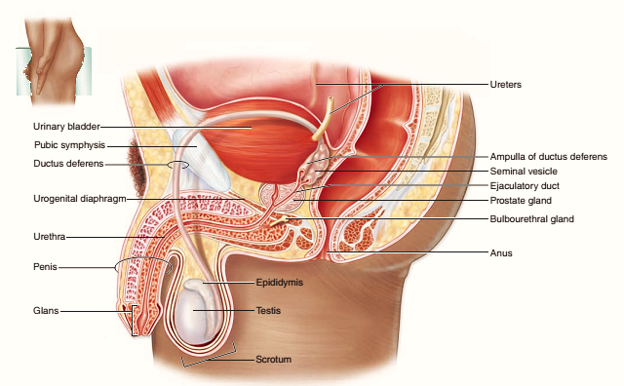
ANATOMICAL ASPECTS:

Slide 3
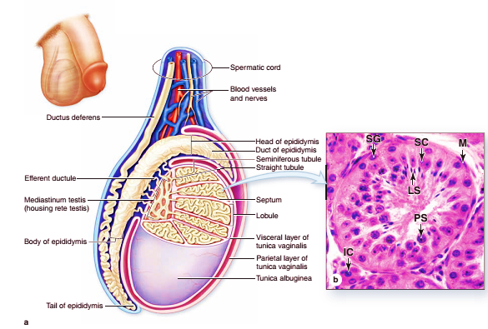
TESTIS
Testis (Testicles) surrounded by dens CT capsule{TONICA ALBUGINEA}.
The ALBUGINEA thickened at back to form MEDIASTINUM TESTIS.
Fibrous septa from her subdivide testis into 250 lobules.
Lobules called TESTICULAR LOBULES.
Each lobule contains:
INTERSTITIAL CT
Endocrine cells(INTERSTITIAL or LEYDIG CELLS): secret TESTOSTERONE.
SEMINIFEROUS TUBULS: in which sperm production occurs.

Slide 4
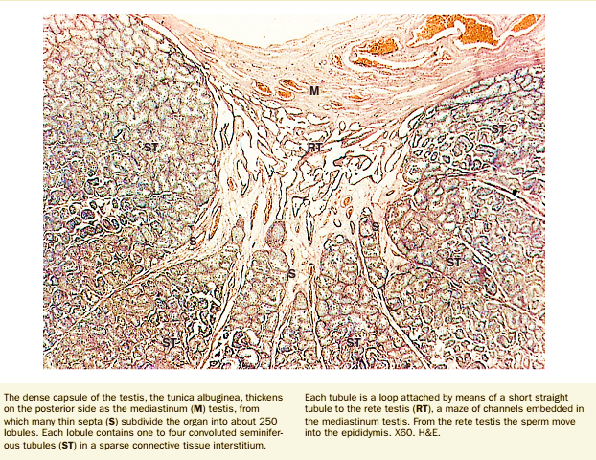
INTERSTITIAL CT
Between seminiferous tubules.
Composed of CT.
Contains:
Fibroblast cells.
Lymphatics.
Blood vessels {fenestrated capillaries}.

Slide 5
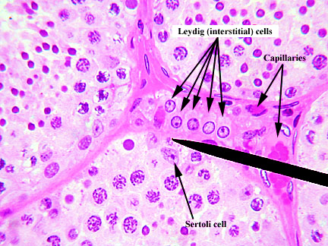
INTERSTITIAL {LEYDIG} CELLS
Large rounded or polygonal cells.
Have central nuclei.
Eosinophilic cytoplasm rich in small lipid droplets.
These cells concerning with secretion of TESTOSTERONE.

Slide 6
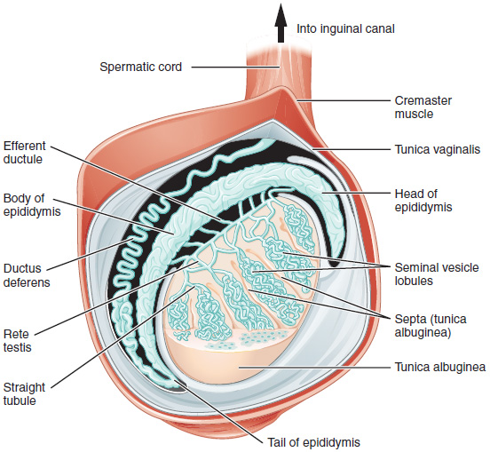
SEMINIFEROUS TUBULES
Within the testis lobules.
Each testis contains from 250-1000 tubule.
Each tubule measures about 150-250 micron in diameter, 30-70 cm in length.

Slide 7
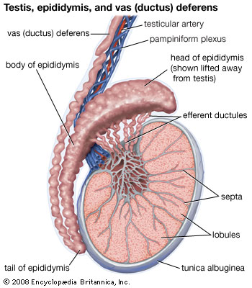
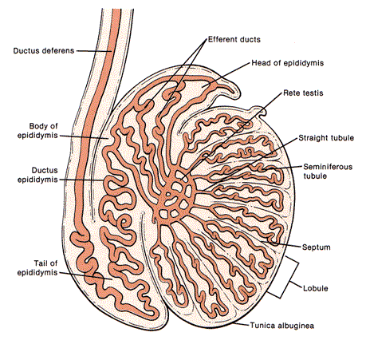
SEMINIFEROUS TUBULES
Each tubule linked to RETE TESTIS through STRAIGHT TUBULE.
RETE TESTIS is epithelial – lined canals embedded in MEDIASTINUM TESTIS.
RETE TESTIS connected to head of EPIDIDYMIS through EFFERENT DUCTULES.

Slide 8
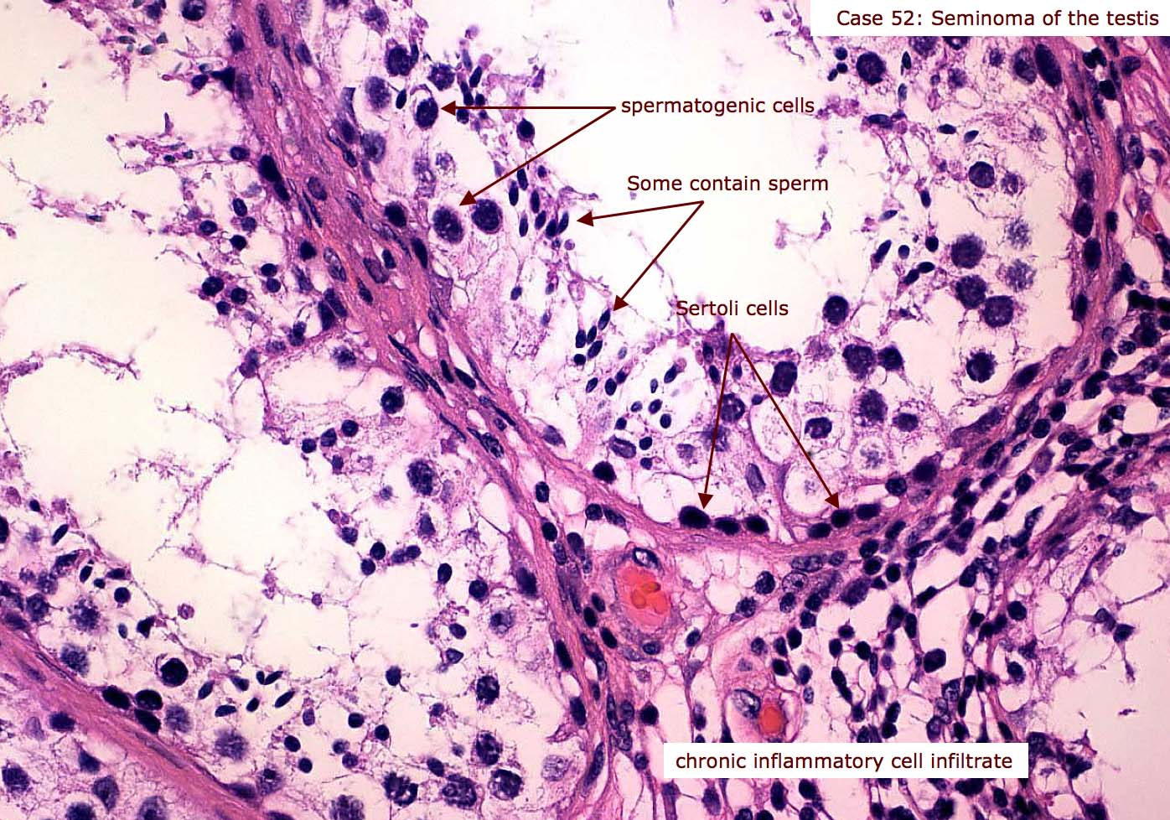
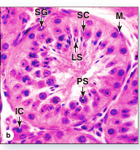
SEMINIFEROUS TUBULES: STRUCTURES

Slide 9
SEMINIFEROUS TUBULES: STRUCTURES
Each tubule lined by complex stratified epithelium{SPERMATOGENIC EPI}.
Epithelium rests on basement membrane.
The membrane contains smooth muscle-like cells {MYOID CELLS}.
Germinal epithelium (spermatogenic EPI) consists of:
SERTOLI CELLS: non dividing cells, support developing sperms.
SPERMATOGENIC LINEAGE CELLS: dividing cells.

Slide 10
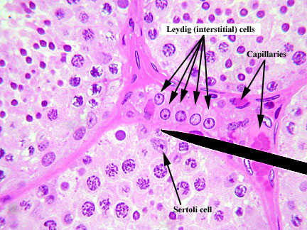
SERTOLI CELLS:
Tall columnar or pyramidal EPI cells.
Forming the basal lamina of ST.
These cells make a BLOOD – TESTIS BARRIER.
FUNCTIONS:
Support, Protection, Nutrition of Spermatogenic.
Exocrine& Endocrine.
Phagocytosis.

Slide 11
INTRATESTICULAR DUCTS
Intra-testicular ducts include:
STRAIGHT TUBULES (tubuli recti).
RETE TESTIS.
EFFERENT DUCTULES.
They carry spermatozoa and liquid to EPIDIDYMIS.

Slide 12
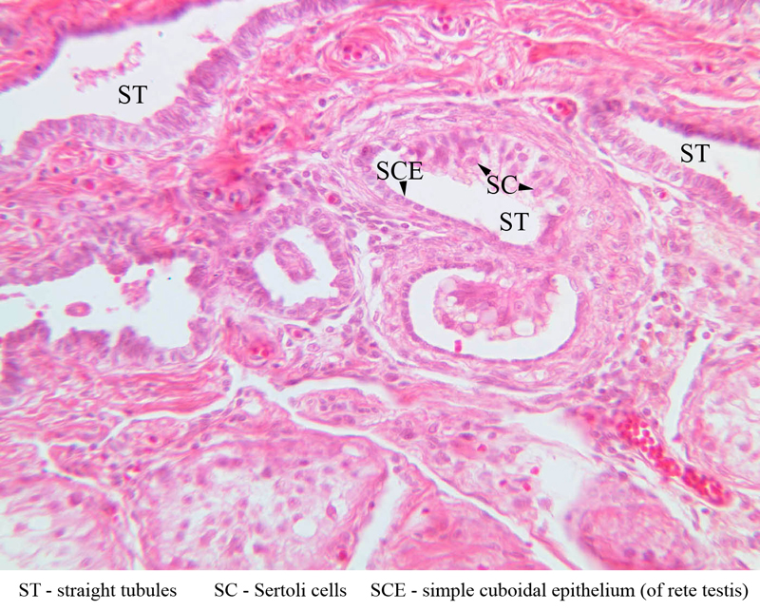
Straight Tubules
Join seminiferous tubules with rete testis.
Lined by SERTOLI CELLS.

Slide 13
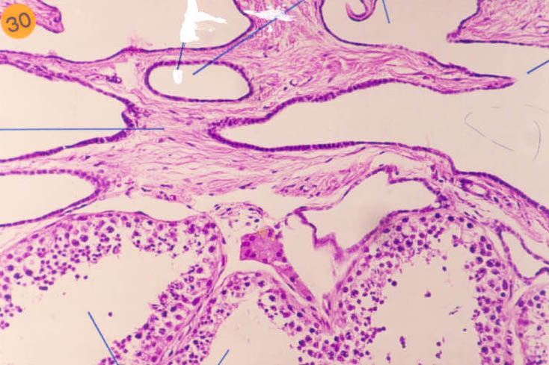
Rete Testis
Interconnected network of channels.
Lined by SIMPLE CUBOIDAL EPI.

Slide 14
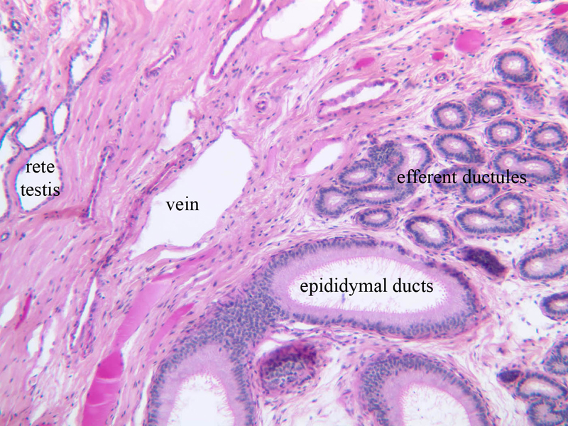
Rete Testis

Slide 15
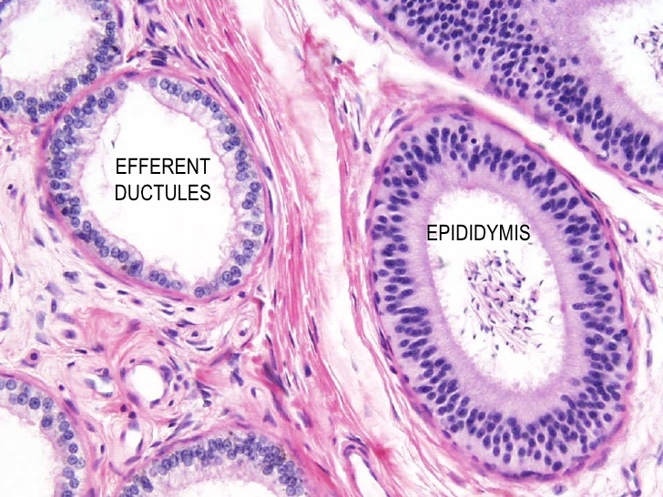
Efferent Ductules
Connect RETE with head of EPIDIDYMIS.
Lined by:
NON-CILIATED CUBOIDAL EPI.
TALL CUBOIDAL CILIATED EPI.
The epithelial layer supported by thin smooth muscle layer.

Slide 16
TO BE CON…..

Slide 17
EXCRETORY GENITAL DUCTS
Include:
EPIDIDYMIS.
DUCTUS {VAS} DEFERENS.
URETHRA.

Slide 18
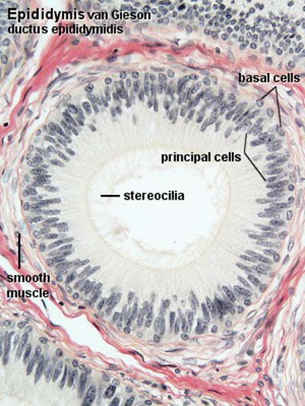
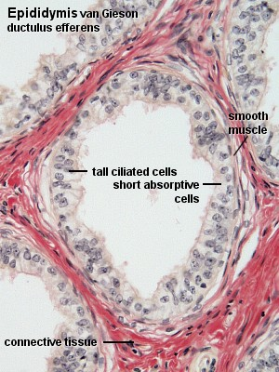
Epididymis: Structures.
Lined by PSEUDOSTRATIFIED COLUMNAR EPI.
This includes:
PRINCIPAL CELLS: Columnar cells with long stereocilia.
STEM CELLS: Small rounded cells.
Externally:
Surrounded by smooth muscle layers:
Inner CIRCULAR.
Outer LONGITUDINAL.

Slide 19
Epididymis: Structures.

Slide 20
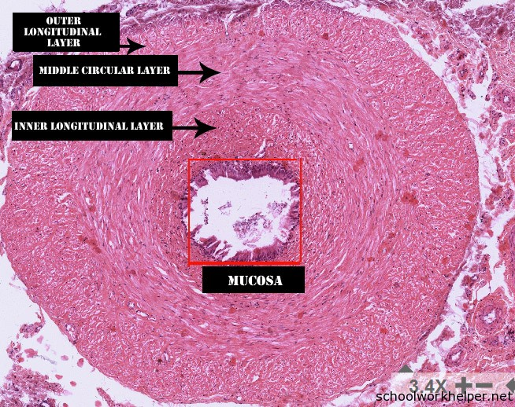
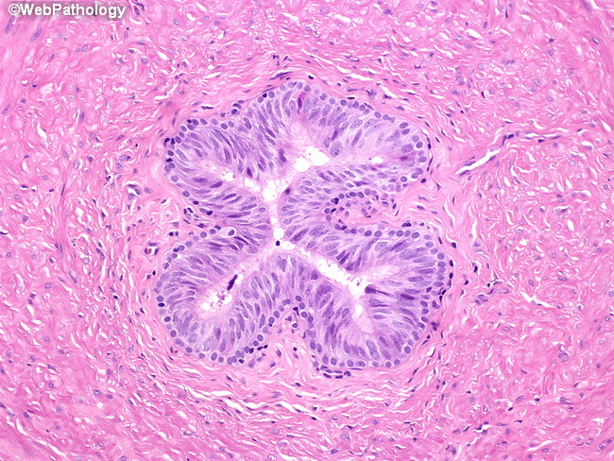
Ductus or Vas Deferens: Structures

Slide 21
Ductus or Vas Deferens: Structures
Mucosa:
Lined by PSEUDOSTRATIFIED EPI with few stereocilia.
Submucosa:
CT (many elastic fibers).
Muscularis:
Inner LONGITUDINAL.
Middle CIRCULAR.
Outer LONGITUDINAL.
Adventitia:
Thin CT

Slide 22
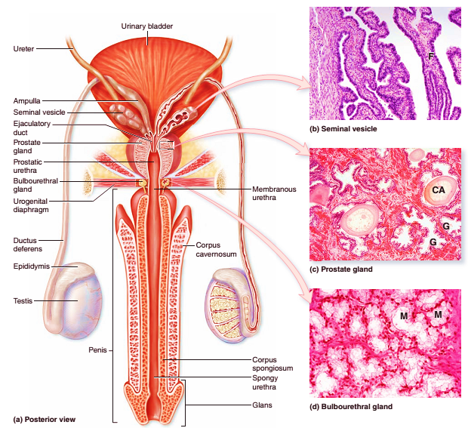
ACCESSORY GLANDS

Slide 23
ACCESSORY GLANDS
Produce secretion mixed with sperm{SEMEN}.
Include:
SEMINAL VESICLES.
PROSTATE GLAND.
BULBOURETHRAL GLAND.

Slide 24
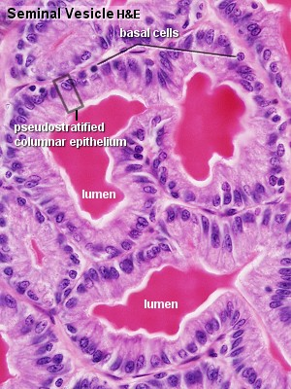
Seminal Vesicles
Consist of highly tortuous tubes.
Surrounded by thin CT CAPSULE.

Slide 25
Seminal Vesicles
Mucosa:
Folded, with SIMPLE or PSEUDOSTRATIFIED COLUMNAR EPI.
Lamina Propria:
Contains elastic fibers.
Muscularis:
Smooth muscle fibers{ Outer longitudinal & Inner circular}.
Adventitia:
CT

Slide 26
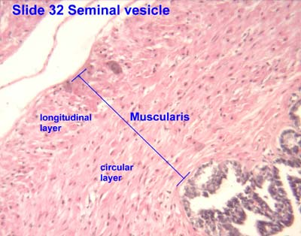
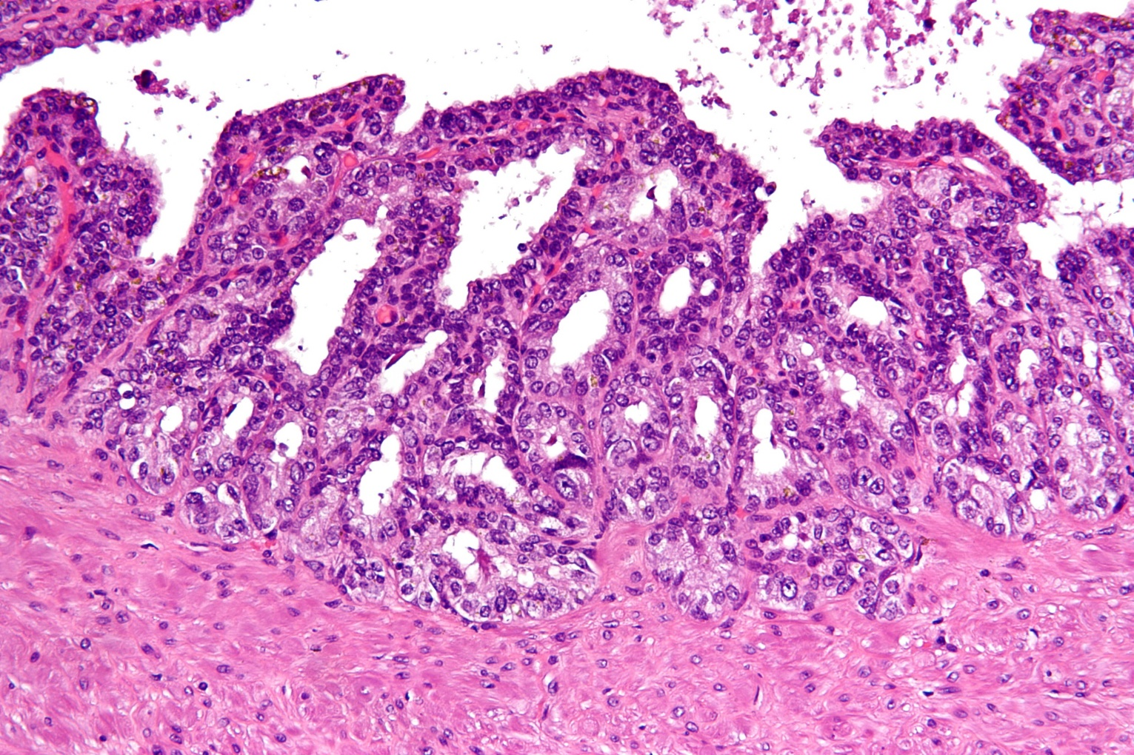
Seminal Vesicles

Slide 27
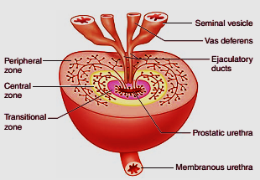
Prostate Gland
It is collection of TUBULOACINAR GLANDS{30-50}.
Embedded in dens fibromuscular stroma.

Slide 28
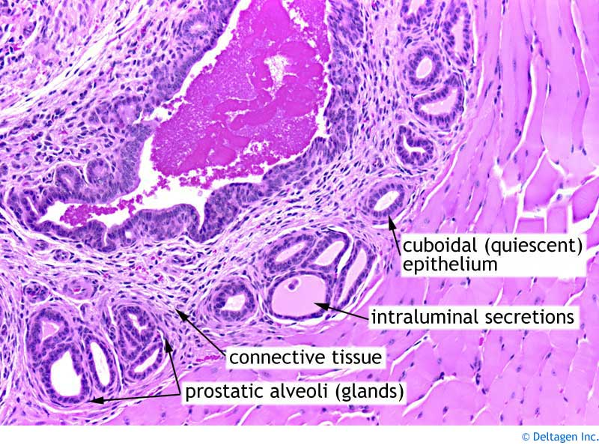
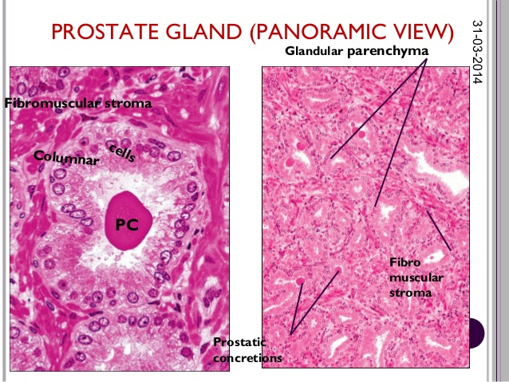
Prostate Gland: structures

Slide 29
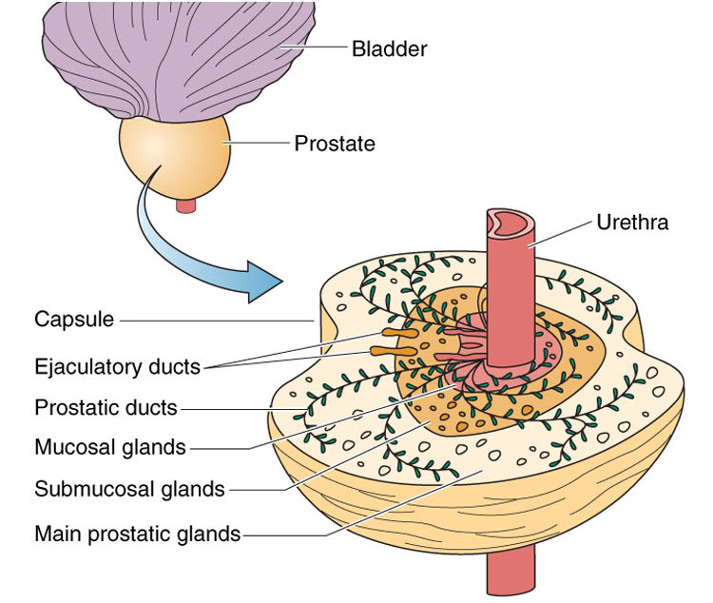
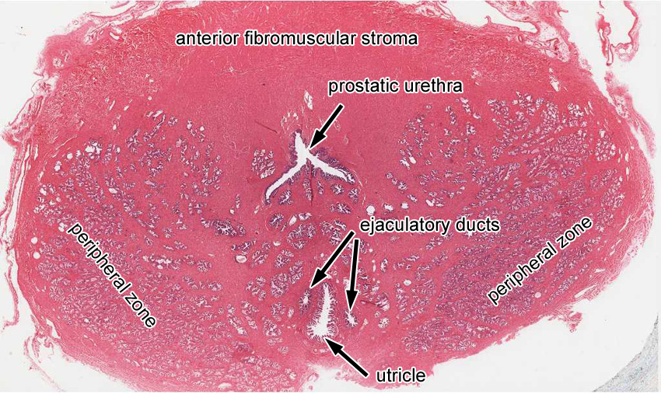
Prostate Gland : structures

Slide 30
Prostate Gland: structures
Structures of gland arranged into:
TRANSITINAL zone:
Occupies about 5%.
Surround urethra.
Contains PERIURETHRAL MUCOSAL glands.

Slide 31
Prostate Gland : structures

Slide 32
Prostate Gland: structures
CENTARL zone:
Occupies about 25%.
Contains PERIURETHRAL SUBMUCOSAL glands.
These glands have long ducts.

Slide 33
Prostate Gland : structures

Slide 34
Prostate Gland: structures
PERIPHERAL zone:
Occupies about 70%.
Contains MAIN PROSTATE’S glands.
These glands have very long ducts.

Slide 35
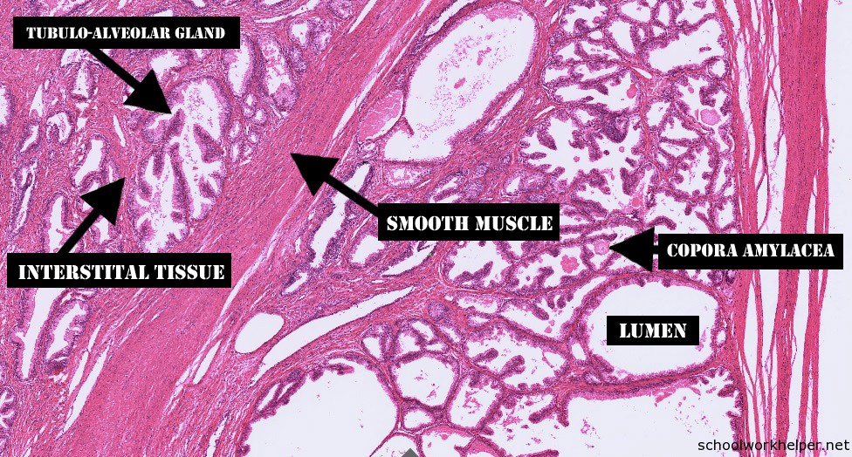
Prostate Gland: structures

Slide 36
Prostate Gland: structures
Tubulo-acinar prostatic glands lined by:
SIMPLE or PSEUDOSTRATIFIED COLUMNAR EPI.
CORPORA AMYLACEA:
Small spherical concretions.
Present in the lumens of many prostatic tubulo-acinar glands.
Partially calcified.
Contain glycoproteins and keratan sulfate.

Slide 37
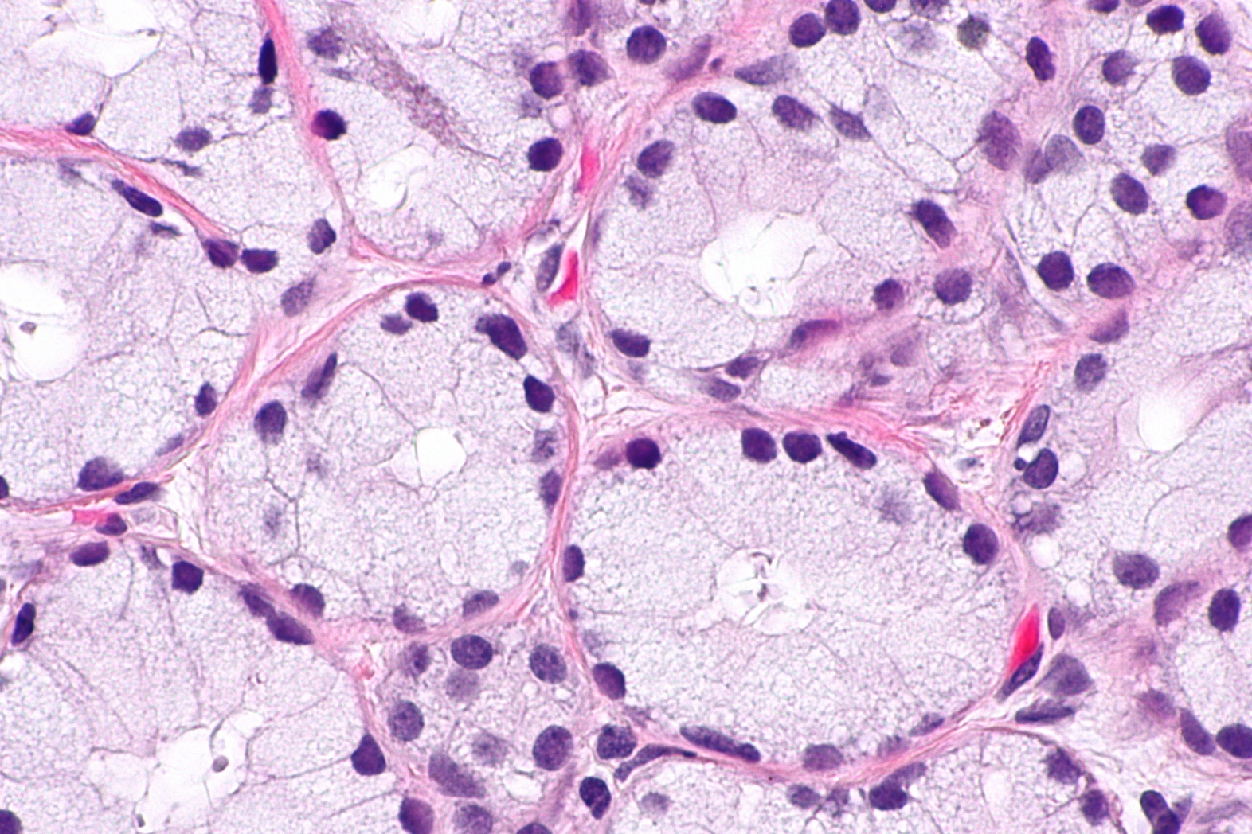
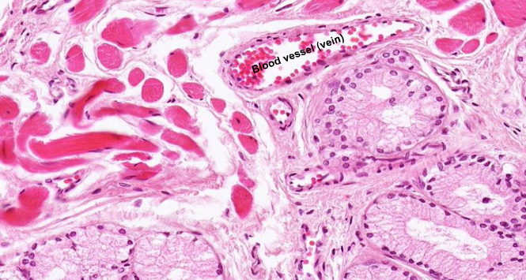
Bulbourethral Glands(COWPER’S GLANDS)

Slide 38
Bulbourethral Glands(COWPER’S GLANDS)
Located in the urogenital diaphragm.
Empty into the proximal part of the penile urethra.
Composed of TUBULO-ACINAR glands.
Lined by SIMPLE COLUMNAR EPI.
Surrounded by SMOOTH MUSCLE CELLS.

Slide 39
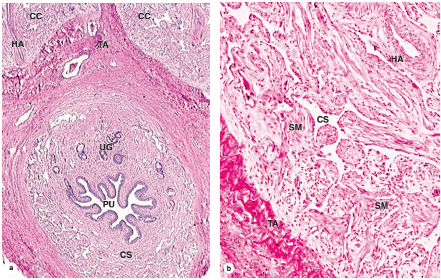
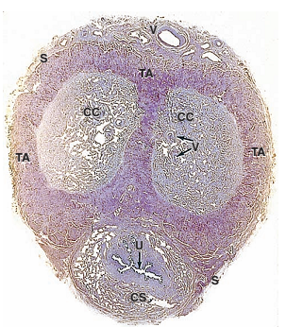
PENIS: Structures

Slide 40
PENIS: Structures
Penile urethra:
Lined by PSEUDOSTRATIFIED COLUMNAR EPI.
At glans: lined by STRATIFIED SQUAMOUS NON-KERATINIZED.
Corpora:
Composed of VENOUS CAVERNOUS SPACES.
Lined by ENDOTHELIUM.
Separated by TRABICULAE, SMOOTH MUSCLES, and CT.
CORPORA CAVERNOSA surrounded by:
Dens fibro elastic membrane {TONICA ALBUGINEA}.

Slide 41


